Slide 1
On your index cards answer these questions and pass to the front. (early bird activity)
What way/s do you imagine generative AI (like ChatGPT) might change society in the next 5 years?
What values or abilities will be necessary to prevent harm/promote responsible decision-making related to these changes?
Notes:
If you’re coming in early I’d love for you to answer these questions on an index card and then pass them to the front
Note for Abha: I would like to collect cards and read some of them to help prime thinking about the AI knowledge capital of the future- hopefully to begin faculty thinking about what kinds of values they want to impart on students. Maybe you can choose some good ones to bring me to read?

Slide 2
The Balancing Act: Teaching and Learning with AI from a Place of Integrity
Melanie Sage, PhD, LCSW melaniesage.com
Notes:
Call me Melanie. I’d like to share how I got here.
After years in social work direct practice, I worked for 12 years as a social work professor. As an early tech adopter I’ve always been fascinated with the impact of tech on human behvior.
With colleagues I wrote a book on teaching with technology.
Experiencing some academic burnout and desiring real world impact, I left my tt post at UBSSW to work on global tech equity at Meta, owners of Facebook, Instagram, etc.
After a year, I left this role and returned to self-employment, and now I adjunct, train, research, and write- I had to quit my job as an academic to find the time to do these things that I love!
Very happy to be with you today to help you kick of your day of peer learning.

Slide 3
Today’s Talk
How do our personal and professional values inform our choices about technology use?
How does this inform our classroom policies and practices?
How can we discuss generative AI policies with students in ways that resonate with their values about learning and higher education?
What do students (and society) need from us related to generative AI?
Notes:
The purpose of today’s talk is to help answer these questions (read slide)
I’d like to note, before we start, that all images in presentation were generated with Midjourney. Feel free to count the fingers in the photos. IYKYK
I used Claude.ai to help brainstorm and give feedback on some portions of this talk.
Let’s normalize disclosure of AI use, which is good modeling for students.
Today, feel free to take photos of slides- they will also be available to use digitally after this session.

Slide 4
What is Technology?
Computer scientist Alan Kay, inventor of the concept of computer windows, famously picked up on the way we understand technology by saying we tend to define it as ….
“anything that was invented after you were born.”
Today we’ll focus on Generative AI (GenAI), tools designed to converse in natural language that are capable of mimicking human conversation by accessing a large library of materials used to train them.
Notes:
Let’s start by thinking about how we often define tech. (read slide). Laugh.
When I say Generative AI, I mean tools such as ChatGPT, Claude, Gemini, Perplexity, and many more.
Generative AI may also generate images, but today I am narrowing the focus to text generation, which is having a major impact on teaching and learning, and a big enough topic on its own.

Slide 5
How does it work?
Generative AI uses Natural Language Processing to quickly sort through its Large Language Model (LLM), all the things in its library, and predicts the next word likely to be related to your prompt and its previous words.
It does not reword existing content, it’s only predicting what’s next, one word at a time, based on its LLM content and what it said last.
Notes:
Read slide
You know how on your smartphone there are three words that the text predicts you will use next? It’s a more sophisticated version of that- what word is likely to come next based on context of what has come before?
GenAI is trained on books, web, and other (undisclosed) material to predict which words belong together, just like the predictive text on your phone, and it systematically chooses what to say next based on the likelihood of a word being part of a word string, but does so with randomness to avoid repeating the same sentence for multiple users. It is always different, which makes it difficult to check for plagiarism in our typical ways.
Some people assume that AI is simply rewording copyrighted text. That’s not quite right- but it may be trained on copyrighted text.
For instance, if you wanted GenAI to write a paper on Lincoln, it would access all of its knowledge on Lincoln including books, papers, websites, and historical documents stored in its library, begin writing, and then write the word most likely to come next based on the prompt you have entered and it’s last set of generated words.

Slide 6
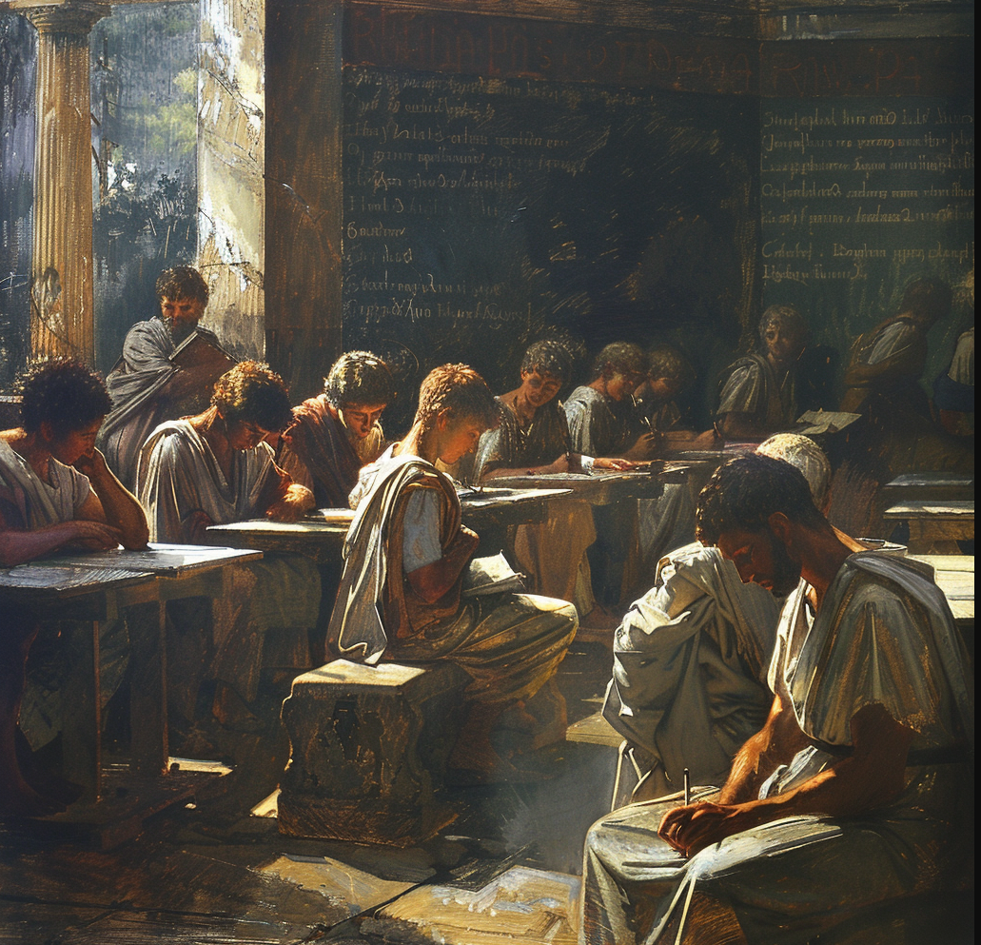
“… for this discovery of yours will create forgetfulness in the learners' souls, because they will not use their memories, they will trust to the external written characters and not remember of themselves. The specific which you have discovered is an aid not to memory, but to reminiscence, and you give your disciples not truth, but only the semblance of truth; they will be hearers of many things and will have learned nothing; they will appear to be omniscient and will generally know nothing; they will be tiresome company, having the show of wisdom without the reality.”
– Socrates, 5th Century BCE
Notes:
Before we consider those big picture questions I mentioned earlier, let’s think about how people have viewed “new technology” through history, focusing on some tech that today is pretty ubiquitous
We’re going way back to Socrates as he resisted teaching people to write (read slide)

Slide 7
“The free access which many young people have to romances, novels, and plays has poisoned the mind and corrupted the morals of many a promising youth; and prevented others from improving their minds in useful knowledge.”
- Reverend Enos Hitchcock, 1790
Notes:
Ok, here’s another- a faith leader in 1790 bemoaning the widespread technology of printed books (read slide)

Slide 8
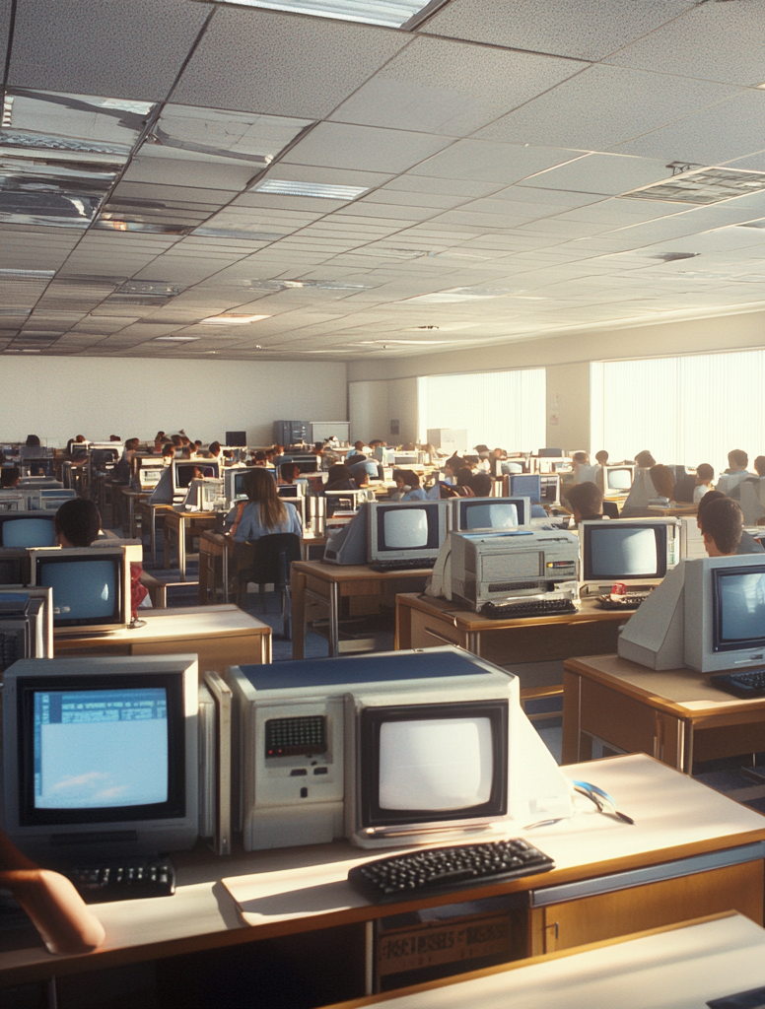
“What I see is a school system, already filled with illiterates, teachers and students, imprisoned by technology and cut off from the flow of ideas. Our contemporary school systems do not do well teaching the alphabet and simple number concepts. Children cannot read, cannot add.
Now, our mavens want to go further and mechanize the whole thing by taking our children away from any contact with reality and making cyborgs of them.”
- Gerald M. Phillips, 1993
Notes:
I’ve got one more- this is about bringing computers into the schools
If you’re like me, you may need to remember that 1993 was 30 years ago, not ten… and we’ve pretty much accepted that computers in schools are here to stay!

Slide 9
Index Card Answers
What way/s do you imagine generative AI (like ChatGPT) might change society in the next 5 years?
What values or abilities will be necessary to prevent harm/promote responsible decision-making related to these changes?
Notes:
Thanks for laughing with me about how we’ve fought technology over the years. These tensions come up because technology changes our sense of how to do things, and of course evokes our values and how we communicate.
As we were getting ready to start our morning, I asked if folks who got here early would answer these questions on index cards. I asked Abha to choose some answers to share.
I’d like to share some of those with you. (read cards). Let’s hold these in our minds as things our future grads may need our help with as we learn together today.
Just as writing, books, and computers are still having a major impact on how we teach, it seems AI is likely going to be around for a while.

Slide 10
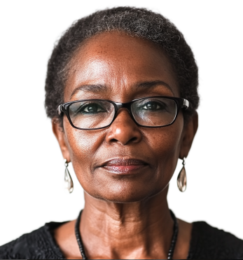
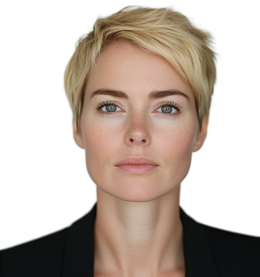
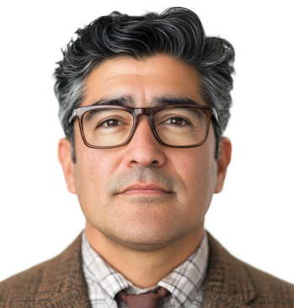
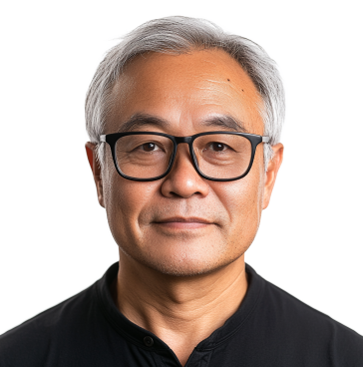
Technology Adoption Curve Everett Rogers’ Diffusion of Innovations, 1962
Let me figure out what others are doing.
I’ll do it if you’re going to make me.
Maybe I can retire before they force me into it.
How can I use this in my work?
Let’s try it and see what happens!
Innovators
Technology Acceptance Model (Is it easy? Is it useful?) Bagozzi, Davis and Warshaw, 1992
Notes:
Let’s start by thinking about WHY and WHEN we adopt tech.
There are two theories that are helpful here
First, the technology adoption curve- people are found to adopt numerous technologies based on this curve.
Think about where you see yourself.
Second, the TAM suggests we adopt a new tech when it is EASY and USEFUL.
I’d like to suggest another criteria- that we adopt when it aligns with our values. This can help us align our choices to our values.
Today, when it comes to thinking about how to approach generative AI in the classroom you might have values-driven feelings about whether to use AI. This that come from gut reactions, emotional responses, personal values, well-researched perspectives, or even from not yet knowing enough about it.
So lets talk about some of the values-related perspectives that we react strongly to, both related to concerns and opportunities of Gen AI

Slide 11
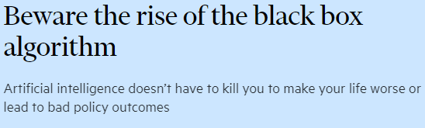
Concerns about GenAI
Notes:
Many of us have been considering genAi as it relates to plagiarism, and perhaps a host of other important social justice considerations that may shape how you use and teach about AI, including things like …
Plagiarism
disinformation
Privacy
Black boxes and corporate creep
Job disruption and equity
Loss of creativity, critical thinking, soft skills
Outsourcing esp to global south for cheap labor, where people may be exploited
Environmental impact
Racism baked in to algorithms- this is a big one!

Slide 12
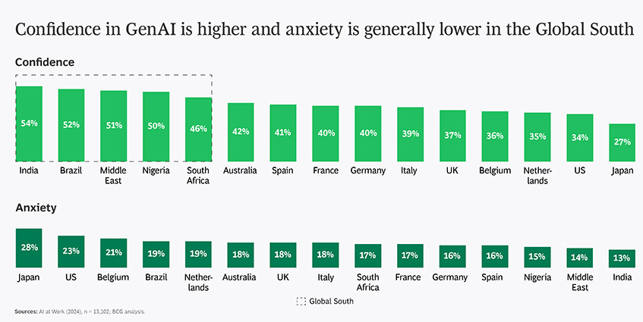
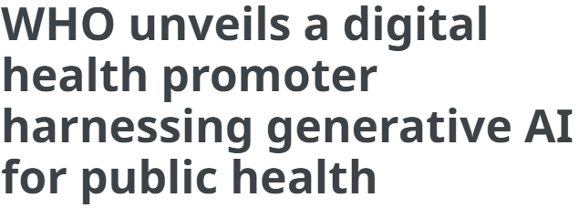
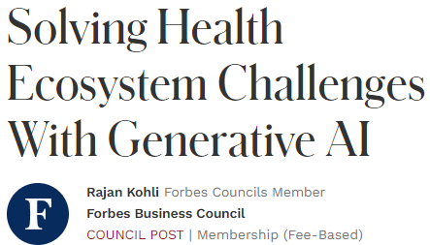
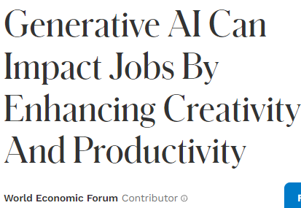
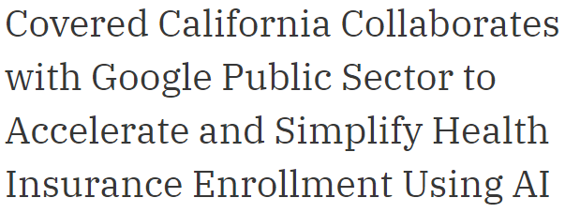
And also opportunities
Notes:
And also, for just about every concern related to generative AI, there are reasons to be hopeful or excited about its potential.
Some suggest it could improve equity
Students say they want to learn to use it
They say it’s helping with grades
It could help creativity and productivity
It could aid accessibility
It is being used to find health solutions
It is being used to solve environmental challenges
People in the Global South are hopeful about the impact
Very relevant to our roles as educators, there are thoughts that AI may widen racial or economic gaps due to uneven learning about AI, but also that AI can help us close achievement gaps in the classroom.
For instance, AI is helping neurodivergent students break down tasks, make lists, and organize their thoughts.
Some use it for tutoring support and to organize study guides.

Slide 13
How do we balance these concerns and opportunities in the classroom and maintain our pedagogical values in the process?
Notes:
Our big overarching questions for today is (read slide)
We can think about pedagogical values as worldviews, beliefs, perspectives, and biases about teaching and learning that underpin our specific educational practices (Palahicky et al., 2017)
I’d like us to think about this because students don’t respond well to “don’t use it, it’s cheating.”
We can’t outrun the technology- as soon as a tool pop up to detect generative AI, another pops up to make it undetectable. And we don’t want to spend our time playing cat and mouse with our students- it takes the joy out of our teaching. Although I do resonate with the challenge.
I hope that if we think together about our teaching values, our choices will be more proactive than reactive when it comes to AI adoption.
To start our thinking about pedagogical values, I would like to share some stories of faculty who already thought through this challenge and how to respond to it.

Slide 14
Meet Professor Peters* Humanities instructor who assigns research papers.
Generally a late-majority tech adopter.
Disallowed AI because she values students learning to think critically about the content, developing an authentic voice, and information literacy related to understanding sources and citations.
Yet despite her “No AI” policy she found students were turning in papers that still lacked voice and read like AI… but she has no “proof” that students are “cheating.”
So she asked for help in a Facebook group for faculty and adopted a helpful rubric she found online.
*Not her real name, illustrative example.
Notes:
Ok, so these two case studies I’m going to share are a bit of a combination of some teachers I’ve worked with.
(read slide)

Slide 15
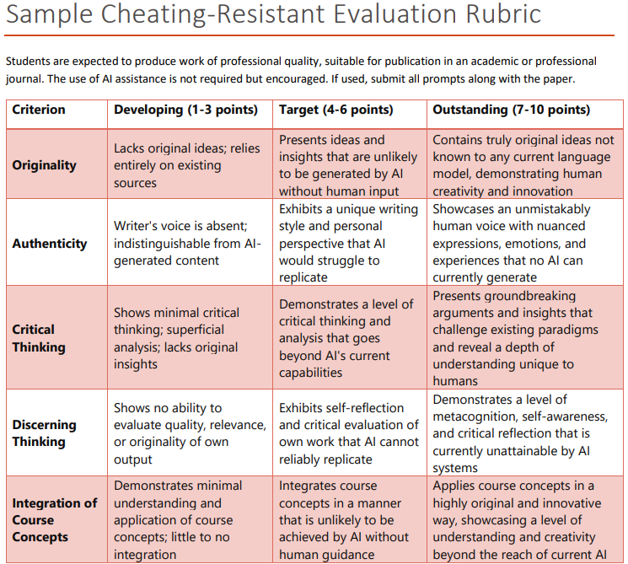
National Institute on Artificial Intelligence in Society CSU Sacramento
http://csus.edu/ai
Available under Creative Commons to use or adapt
Notes:
Here’s the rubric. It focuses on authenticity and integration of course concepts
It’s available at the website here
While this is a good start, it is important to note that research has found that international students who are english language learners are more likely to be accused of using AI, so tools like this may build in bias when we assess for authentic voice, which presents equity issues.
This may relate to both their understanding of classroom expectations and the use of formal writing that can look like AI.

Slide 16
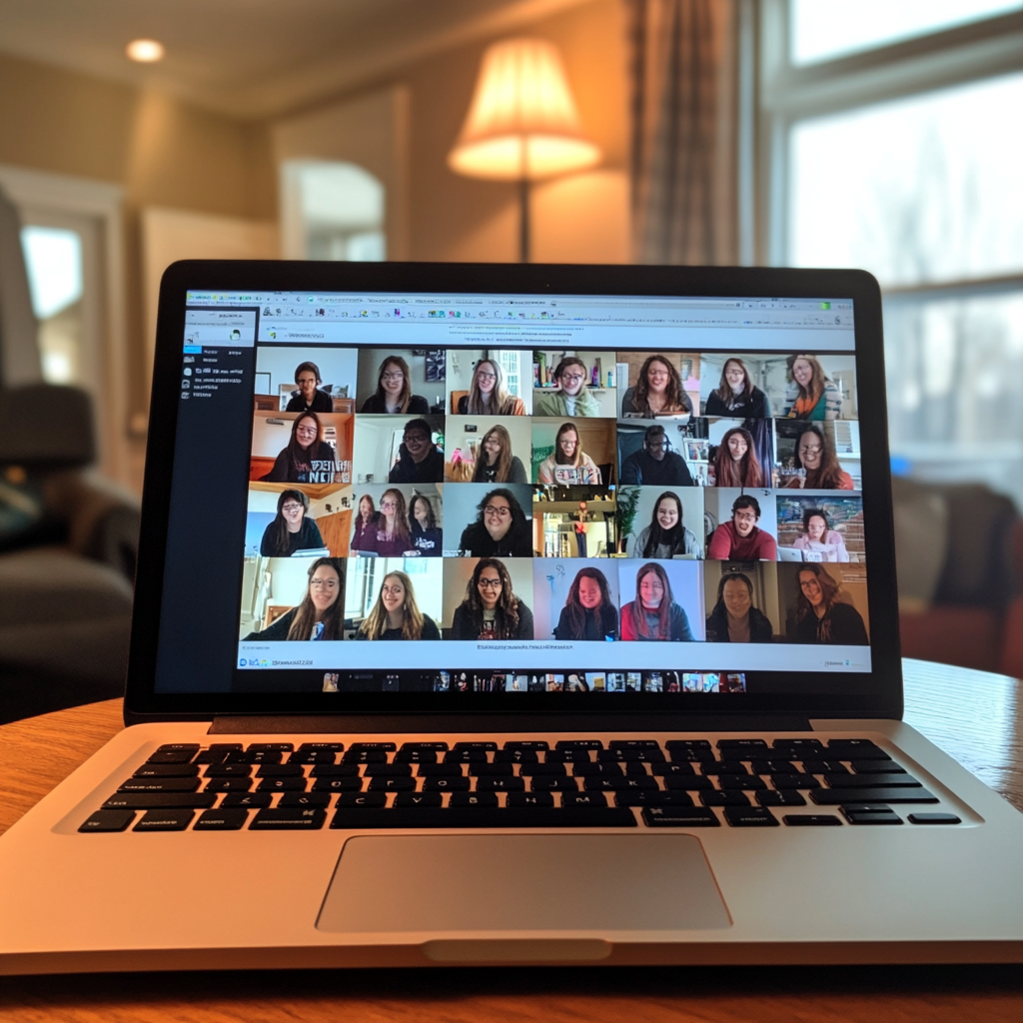
74% of incoming college students say they are knowledgeable or very knowledgeable about AI
55% worry that they won’t be able to compete with other students without using it
Art & Science Group LLC, May 2024 n=1100
42% of professors say they don’t allow AI use although 72% have used it to help create teaching materials Ithaka S+R, Feb 2024 n=2600 faculty
56% of students use GenAI for assignments.
(70% want it incorporated in courses)
Cengage Group, May 2024 n=974 recent grads
Notes:
Notably, most students say (read slide)
We are still divided as an academic community about our stances on AI, but it does seem we will all need to develop some clear expectations about its use.

Slide 17
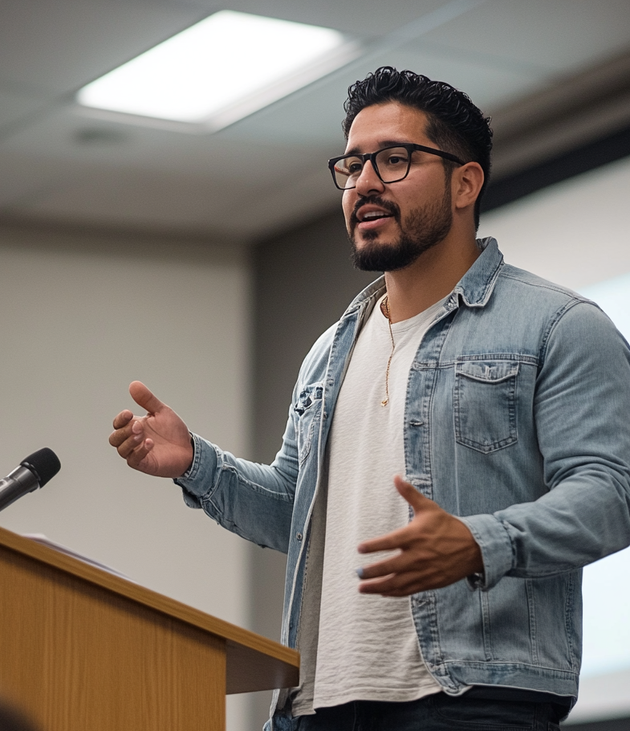
Meet Professor Lopez
Education instructor who assigns individual and group papers
Generally an early tech adopter, using AI himself for help developing assignments and case studies
Wants students to use AI in a good way because he values practical skill development, information literacy and tech ethics, collaborative learning, and critical evaluation of technology.
He asks students to add a footnote about GenAI use effectiveness, and requires the AI chat log as an attachment to the paper. He uses these icons in his syllabus as a key to differentiate assignments where AI use is acceptable.
Icons by Martine Peters, Director of the Partnership on University Plagiarism Prevention, Université du Québec en Outaouais
Notes:
So let’s look at another case study (read slide)
Notice how in both of these case studies values led the practice choices

Slide 18
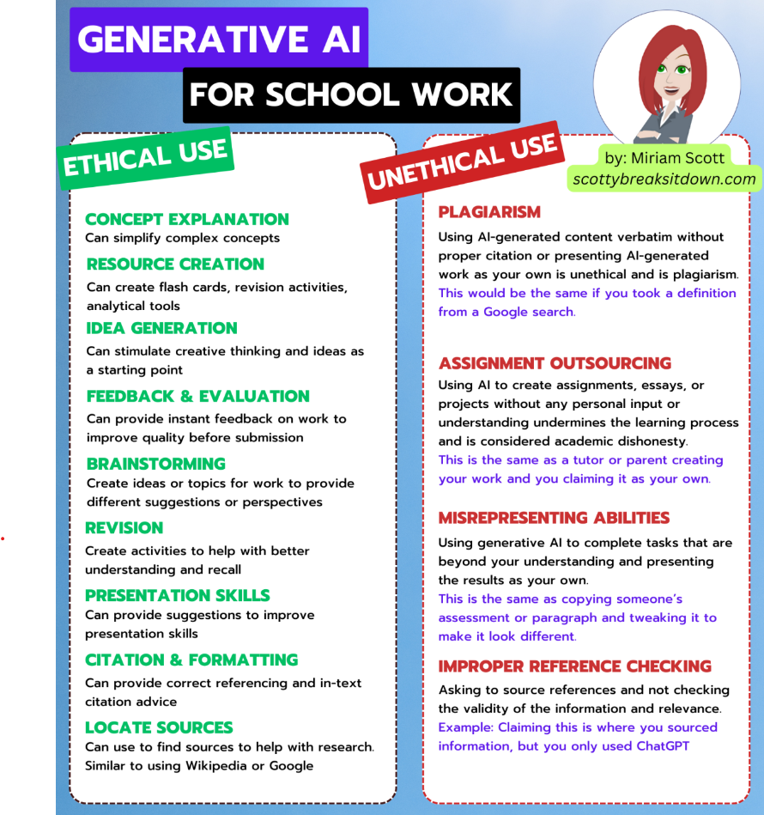
Professor Lopez shares values with students: practical skill development, information literacy and tech ethics, collaborative learning, and critical evaluation of technology.
He explains that when they are teachers they need to be able to evaluate new tech tools well, and understand when they add value.
He asks them to identify their values related to their education and future roles as teachers, and then in small groups make a list of ways that seem acceptable and unacceptable to use AI based on the discussion.
They crowdsource a class document in Google Docs outlining their shared agreements about ethical and unethical use of GenAI, and what it is good/not good for.
Notes:
Dr Lopez explains to his students how these values guide his decisions (read slide)

Slide 19
What teaching values and goals might inform your AI classroom policies and practices?
Cognitive Skills | Learning Approaches | Personal Development
Analytical skills | Collaborative learning | Self-awareness
Critical thinking | Experiential learning | Growth mindset
Problem-solving | Inquiry-based learning | Resilience
Creativity | Individualized learning | Adaptability
Divergent thinking | Self-directed learning | Metacognition
Cognitive flexibility | Interdisciplinary thinking | Emotional intelligence
Systems thinking | Lifelong learning | Time management
Academic & Research Skills | Professional & Practical Skills | Ethical & Social Awareness
Academic integrity | Communication skills | Cultural awareness
Information literacy | Professional ethics | Digital citizenship
Research skills | Professional preparedness | Equity/fairness
Intellectual curiosity | Practical knowledge application | Ethical reasoning
Data literacy | Technological competence | Sustainability awareness
Accessibility | Financial literacy | Global citizenship
Transparency | Entrepreneurial thinking
Notes:
I’m not here to tell you what classroom decisions are right for you, but I think you’ll feel better about your decisions if they are coming from a place of integrity about your pedagogical beliefs
So let’s do what Dr Lopez’ students did- look at this list, and write down a few values from it (or others you might hold) that influence your AI perspectives.
I’m hoping this helps us articulate the reasons we give students a green/yellow/red light about GenAI use.
Thinking about our values can help inform our decisions about when to use or not use AI in the classroom, and can help make it real and sensible to students.
So again, write down 2 or 3 values from this list that resonate with you, or you can choose something note on this list- we’re going to use them for a group exercise

Slide 20
How do your values inform class policy?
Think, write down, and then pair/share at your tables
How might the values you chose inform your class AI policy/practice decisions?
How might you explain your values-informed reasoning to students, in syllabi or discussion?
From a student perspective, is this a compelling response? What might improve it?
Widen the discussion if time allows.
(8 minutes)
Notes:
Think for a minute about your answer to these questions and jot some notes (read questions)
Talk to a table mate or two about your answers
If you finish early, think about how you might use your pedagogical goals or values to build a new assignment that incorporates AI.
(Timer- let’s come back together)
Hopefully this exercise got you thinking about getting beyond initial reactions to AI and gave you time to compare notes with peers
Bonus question: How might you use those same values to build a new assignment that uses or explores AI?

Slide 21
Classroom Policy Examples
Suggestion: First articulate your values/goals/rationale, and then state your parameters.
Liberal
Moderate
Conservative
AI tools are encouraged as learning aids and research assistants. Students may use AI for brainstorming, drafting, and editing their work, but must disclose AI use and critically engage with AI-generated content. Final submissions should demonstrate original analysis and intellectual contribution beyond AI assistance. You are responsible for all submitted work.
AI tools may be used for specific, instructor-approved tasks such as grammar checking or preliminary research. Students must attach a link to the prompt for any AI assistance.
Critical assignments and exams must be completed without AI. Instructors will provide guidance on appropriate AI use for each course and assignment.
The use of AI tools for coursework is prohibited unless explicitly authorized by the instructor for specific learning exercises.
All assignments are expected to be the original work of the student.
Any unauthorized use of AI will be treated as academic dishonesty and subject to disciplinary action.
Notes:
There are many ways to set policy for the classroom, and again, I’m not here to tell you which policy is right for you.
But I do suggest, whichever kind of policies you choose, you share your reasoning with students
We all want to know why a rule exists before we follow it.

Slide 22
Thought Exercise
Help students consider practical reasons to learn without AI
What is an example of a situation in your discipline in which a student might have a real-world professional experience where they couldn’t or shouldn’t use AI even though AI might be capable of completing the task?
For instance, social workers may be able to use AI to generate a client diagnosis. However, they wouldn’t know whether it made sense or have the tools to explain rationale to the client without deeply knowing criteria and considerations, and they risk disclosing protected health information when using AI with client info.
Notes:
I have another thought exercise. This time I want you to think about (read slide)
Social workers may also have to justify the diagnosis to other care providers, insurance companies, or testify about it on the stand.
What are some reasons in your discipline that make sense to students why they would want to do things manually that AI might be capable of doing?
Will a few people share- your discipline and then your situations?
(Take a few answers from audience from across disciplines)

Slide 23
There are many reasons to be nervous
and to be excited about generative AI!
Today we took a step back to consider how AI aligns with our pedagogical goals and what our communities need from our graduates.
You might have good reasons to not use or use these tools in your class.
Perhaps you got a little closer to thinking about how to incorporate an AI policy or practice from a place of integrity and in alignment with your values and goals in the classroom today, and ideas about how to talk about it with students.
Notes:
Read slide

Slide 24
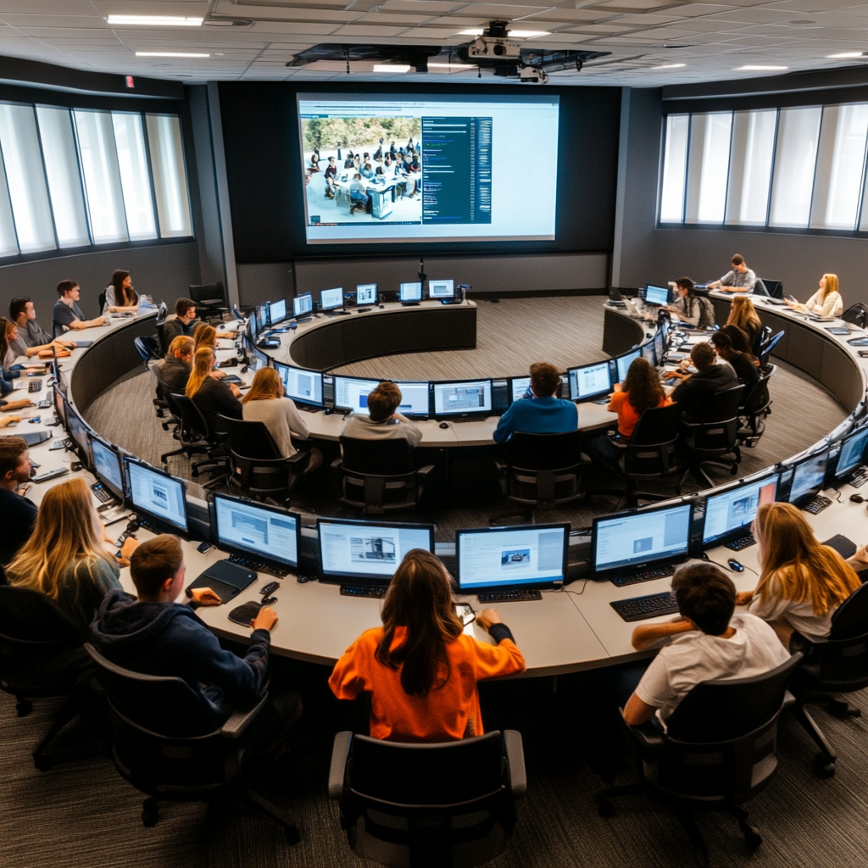
A Vision For the Future
AI enhances, not replaces, human thinking and belonging.
AI helps us meet the needs of all learners and also improves the lives of faculty.
University faculty are thought leaders in shaping use of AI in society and help students rise to the occasion of responsible AI use.
Students leave college ready to help design communities, work, and products that are thoughtful about ethical AI.
Notes:
I want to leave you with some last thoughts about a vision for the future, or perhaps my hopes more specifically. (read slide)
I don’t have a blueprint for how to actualize all of these- but I perhaps as a community of scholars we can work toward them together.
You’ll be off to sessions soon to learn more about how your peers are integrating AI tools and what’s working, and I hope as you leave you will think about how your values about teaching and your values for the community live in your curriculum and classroom.

Slide 25
GenAI Teaching Resources
A futuristic montage related to higher education and AI. It is an outdoor scene, and includes college students, professors, AI tools, scenes of everyday life mixed in with AI-related futuristic imagery. It has a pleasant ethereal feel. - @Melanie Sage {Midjourney Prompt}
Notes:
Thank you so much for having me today
I am happy to take some questions. I think Abha is going to help get the mic to people
As she does that, I’ll share with you an example prompt I used to create this image
You can also access this resource list at Google Docs, and I’d love if you also contribute to it by making suggestions within the doc
(Take questions)
Please feel free to say hi throughout the day after this session. Be well!

